Slide 1

Data Analyst Professional Practical Exam
Pens and Printers new product line sales

Slide 2




Overview
Business goals
Analysis findings
Business metrics
Recommendations

Slide 3
Business goals
With the recent launch of our new product line of office stationery, we were determined to evaluate our sales approach in order to ensure effectiveness and reduce the costs. Our goal was to find the most cost-effective techniques to sell our new products and build a framework for making the decision quicker in the future.
In this project, the three different sales strategies were tested: targeted email and phone calls, and the combination of the two. The sales team expressed interest in the following insights:
Revenue spread and number of customers for each approach;
Differences in revenue over time for each sales method.

Slide 4
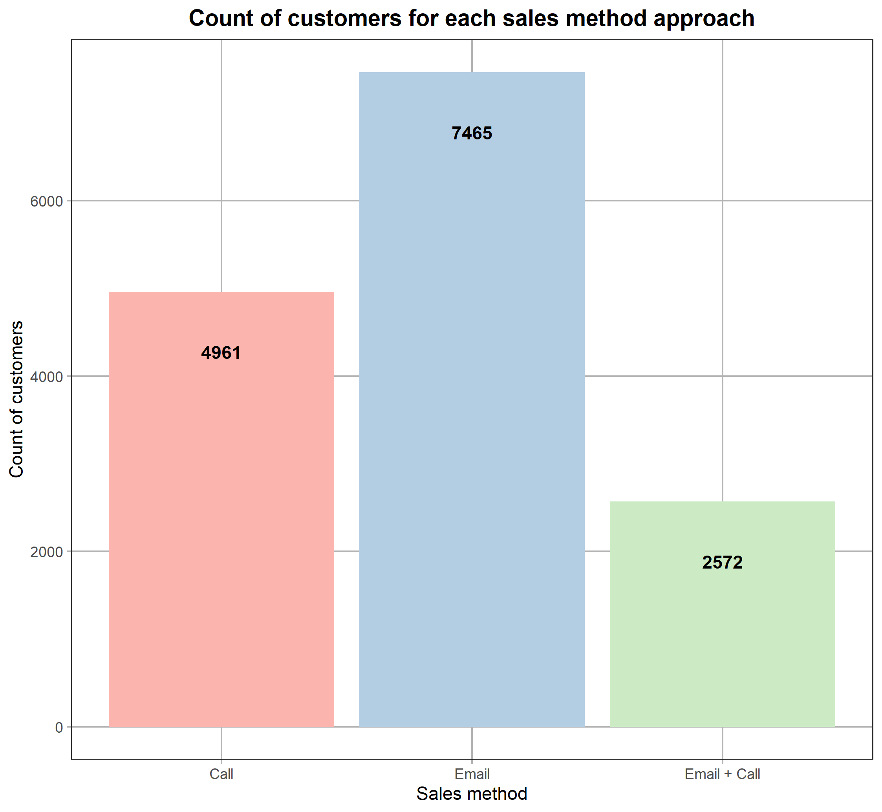



Findings – customers
14998 customers
Almost 50% of customers were contacted by email
17,1% of customers were contacted by email and then called a week later
+

Slide 5
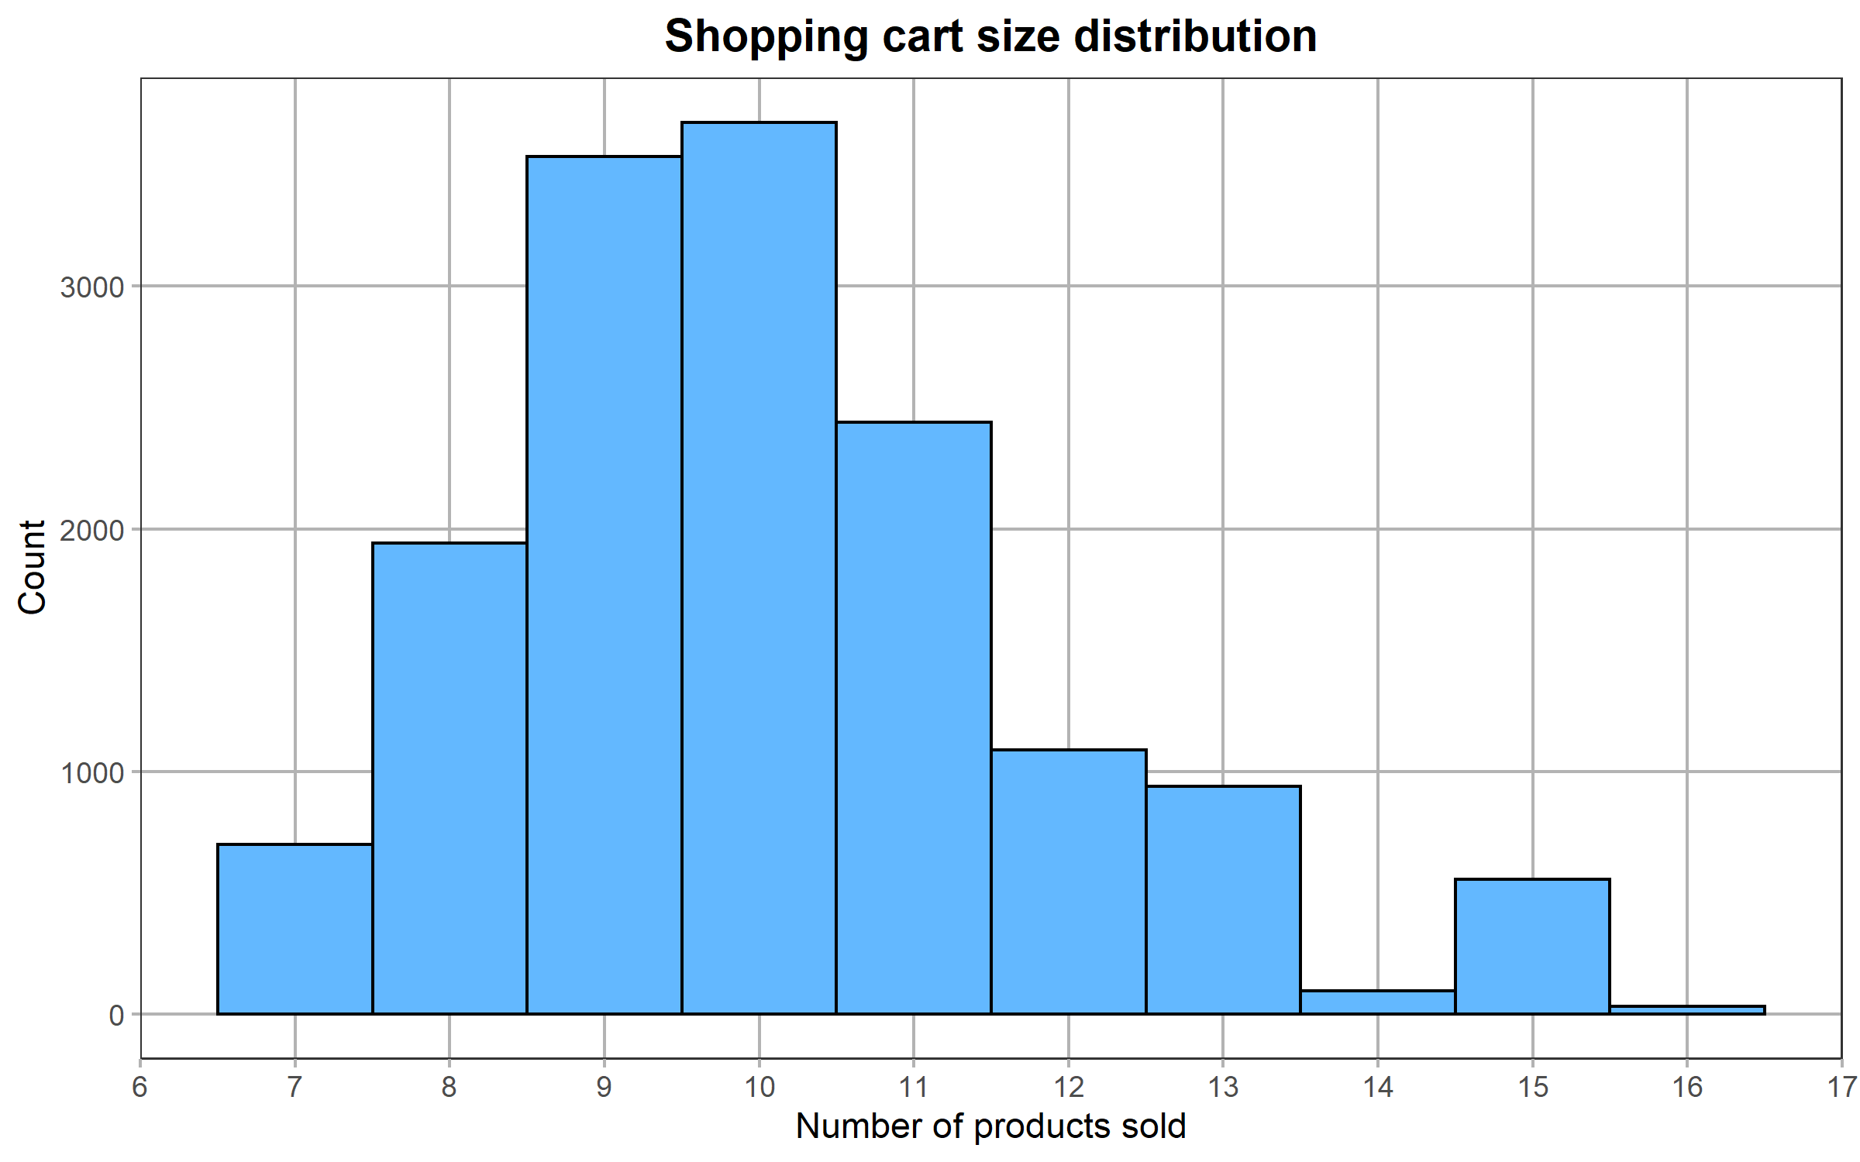

Basket size
Average basket size - 10 units
The most frequent basket size falls between 9 and 10 items per sale

Slide 6
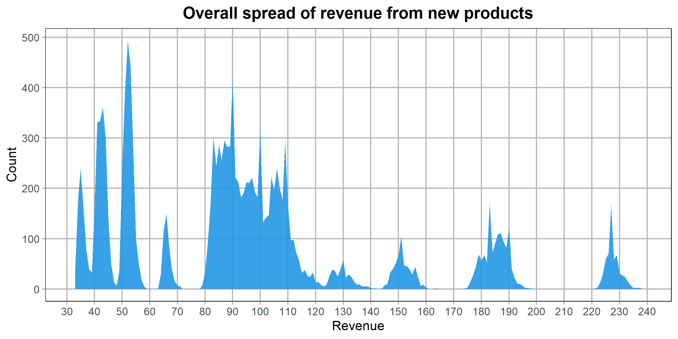
Revenue spread
The revenue per sale has a wide range and spreads from 32.54 USD to 238.32 USD;
Over the last 6 weeks, the sale’s revenue usually fell between approximately 80 USD and 110 USD.

Slide 7
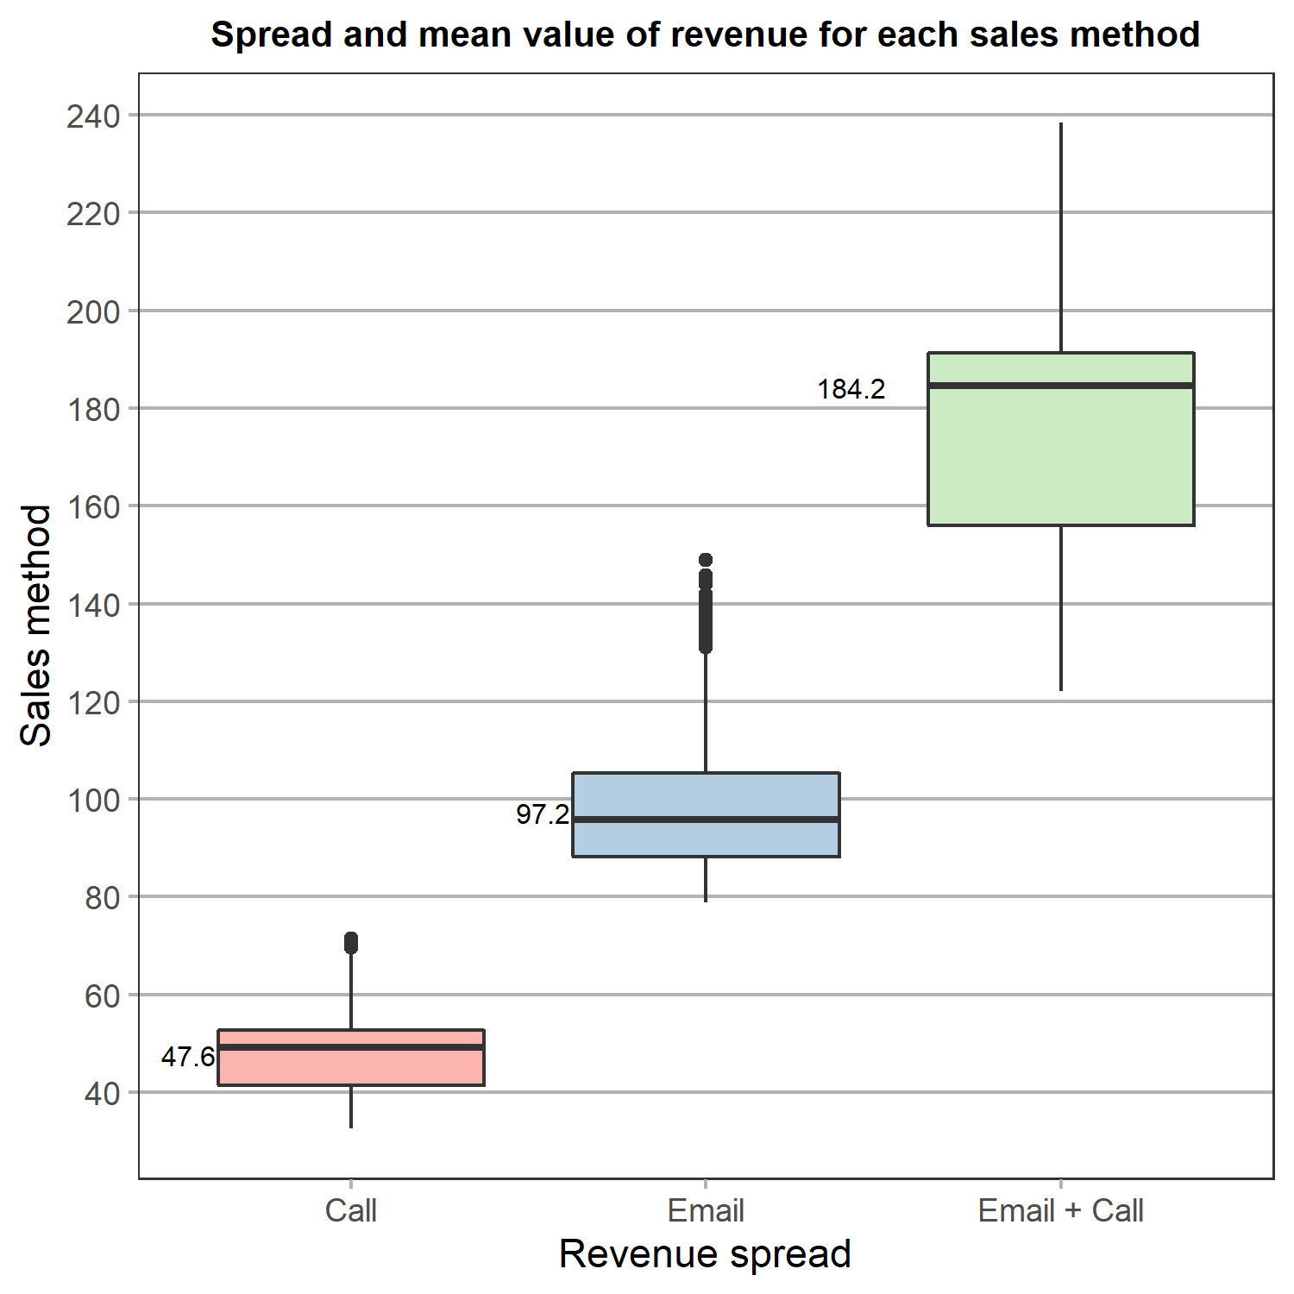
Revenue spread
Average revenue per sale:
47.6 USD
97.2 USD
+
184.2 USD

Slide 8
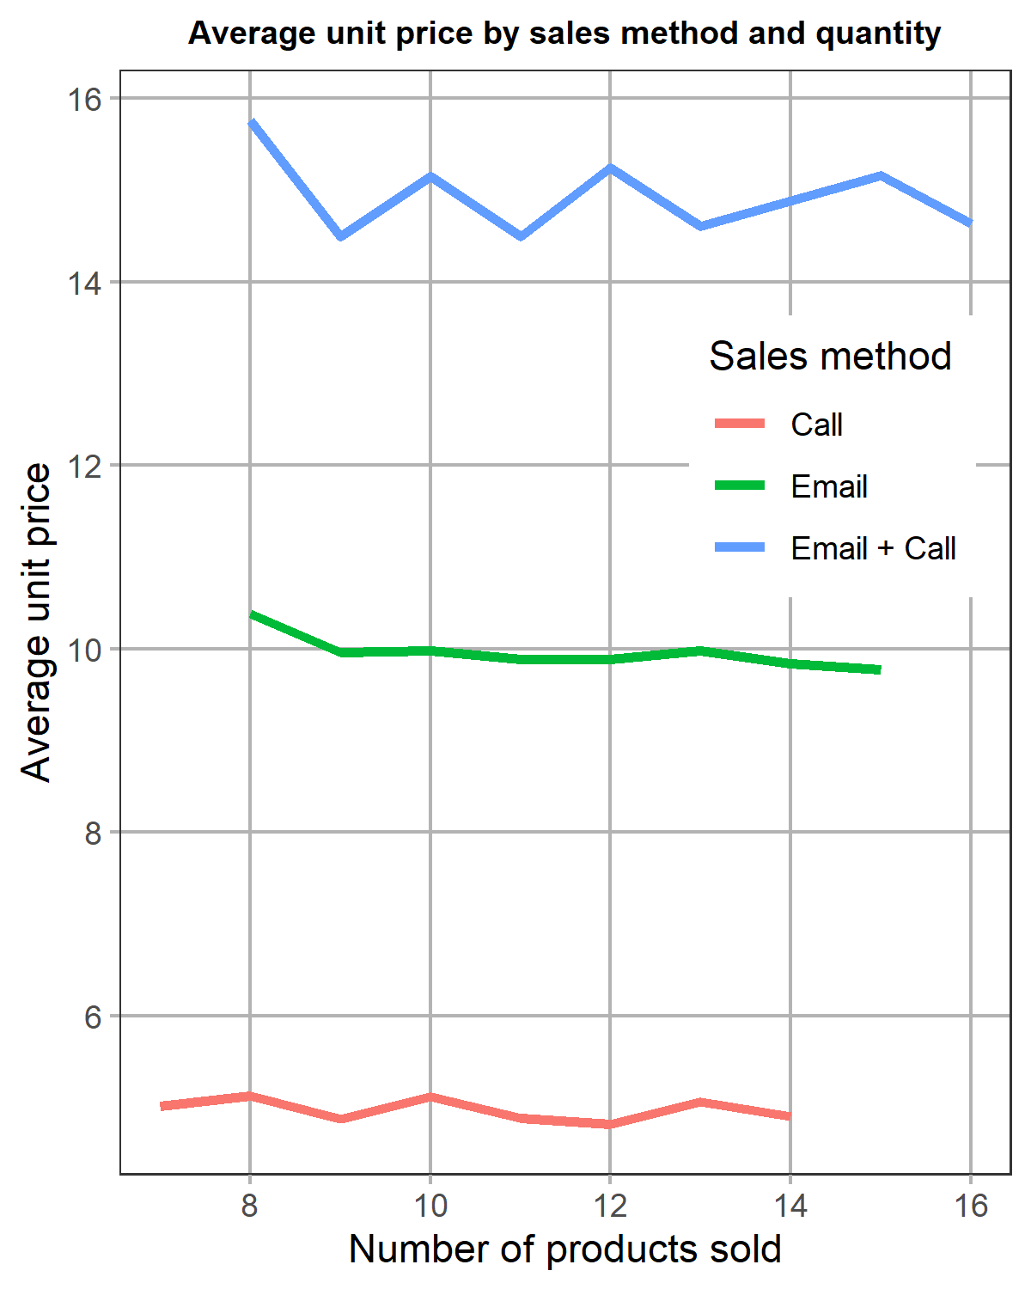
Unit price
Is higher revenue related to higher quantities of products sold during the testing period?
+
By contacting via Email and Call, sales team members were able to convince customers to purchase higher valued products from the new line
Customers are more likely to purchase lower-priced items quickly and without getting additional visual information via phone calls

Slide 9
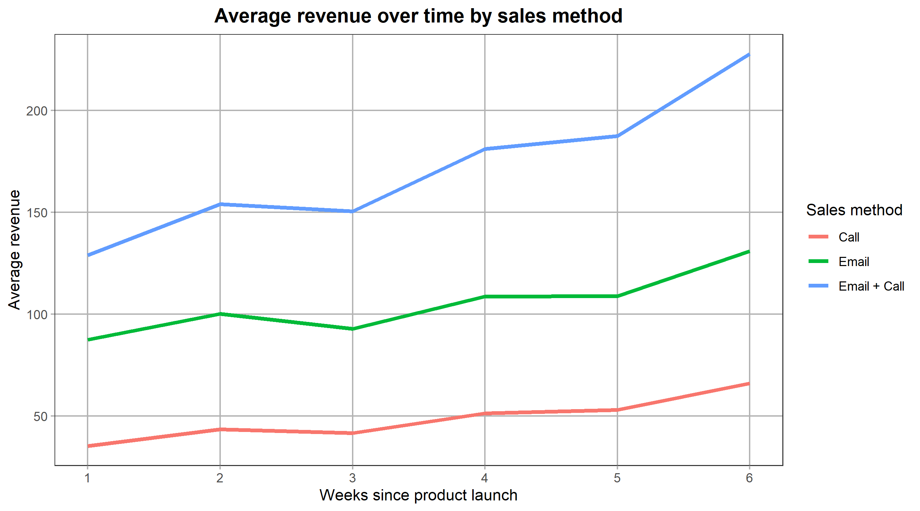



Revenue over time
Email + Call method demonstrates the highest average revenue per sale and the steepest growth over time
The upwards trend over the testing period portrays that customers take their time to make the purchasing decision
The time the customer was contacted again does not significantly influence the sales method's effectiveness

Slide 10
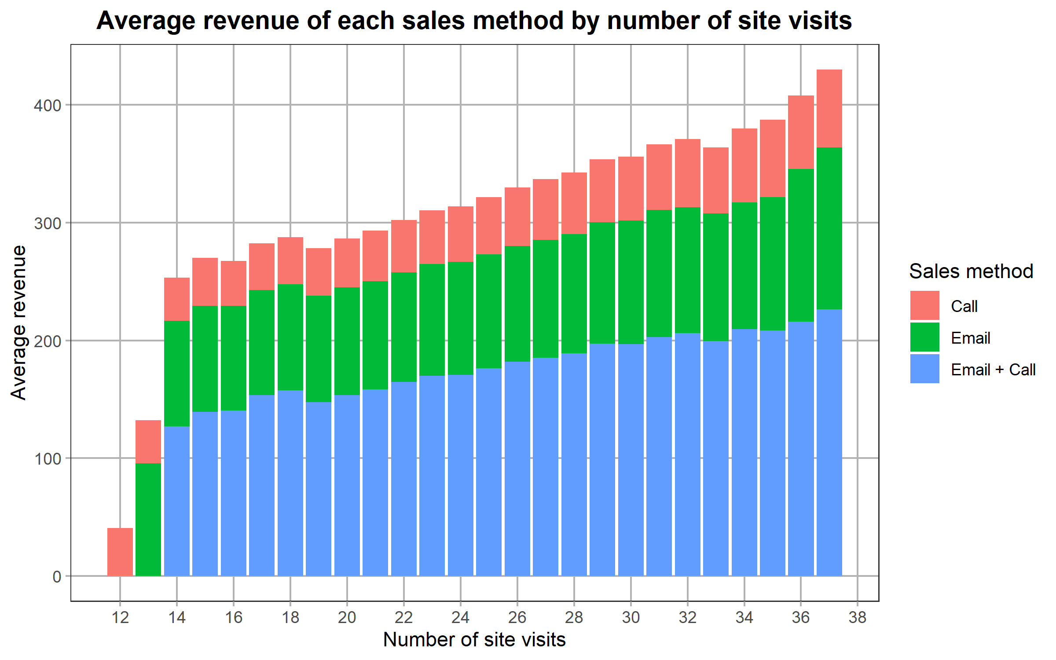
Site visits
More information = higher valued sales
For some customers, the information on the company's site might be the main deciding point

Slide 11

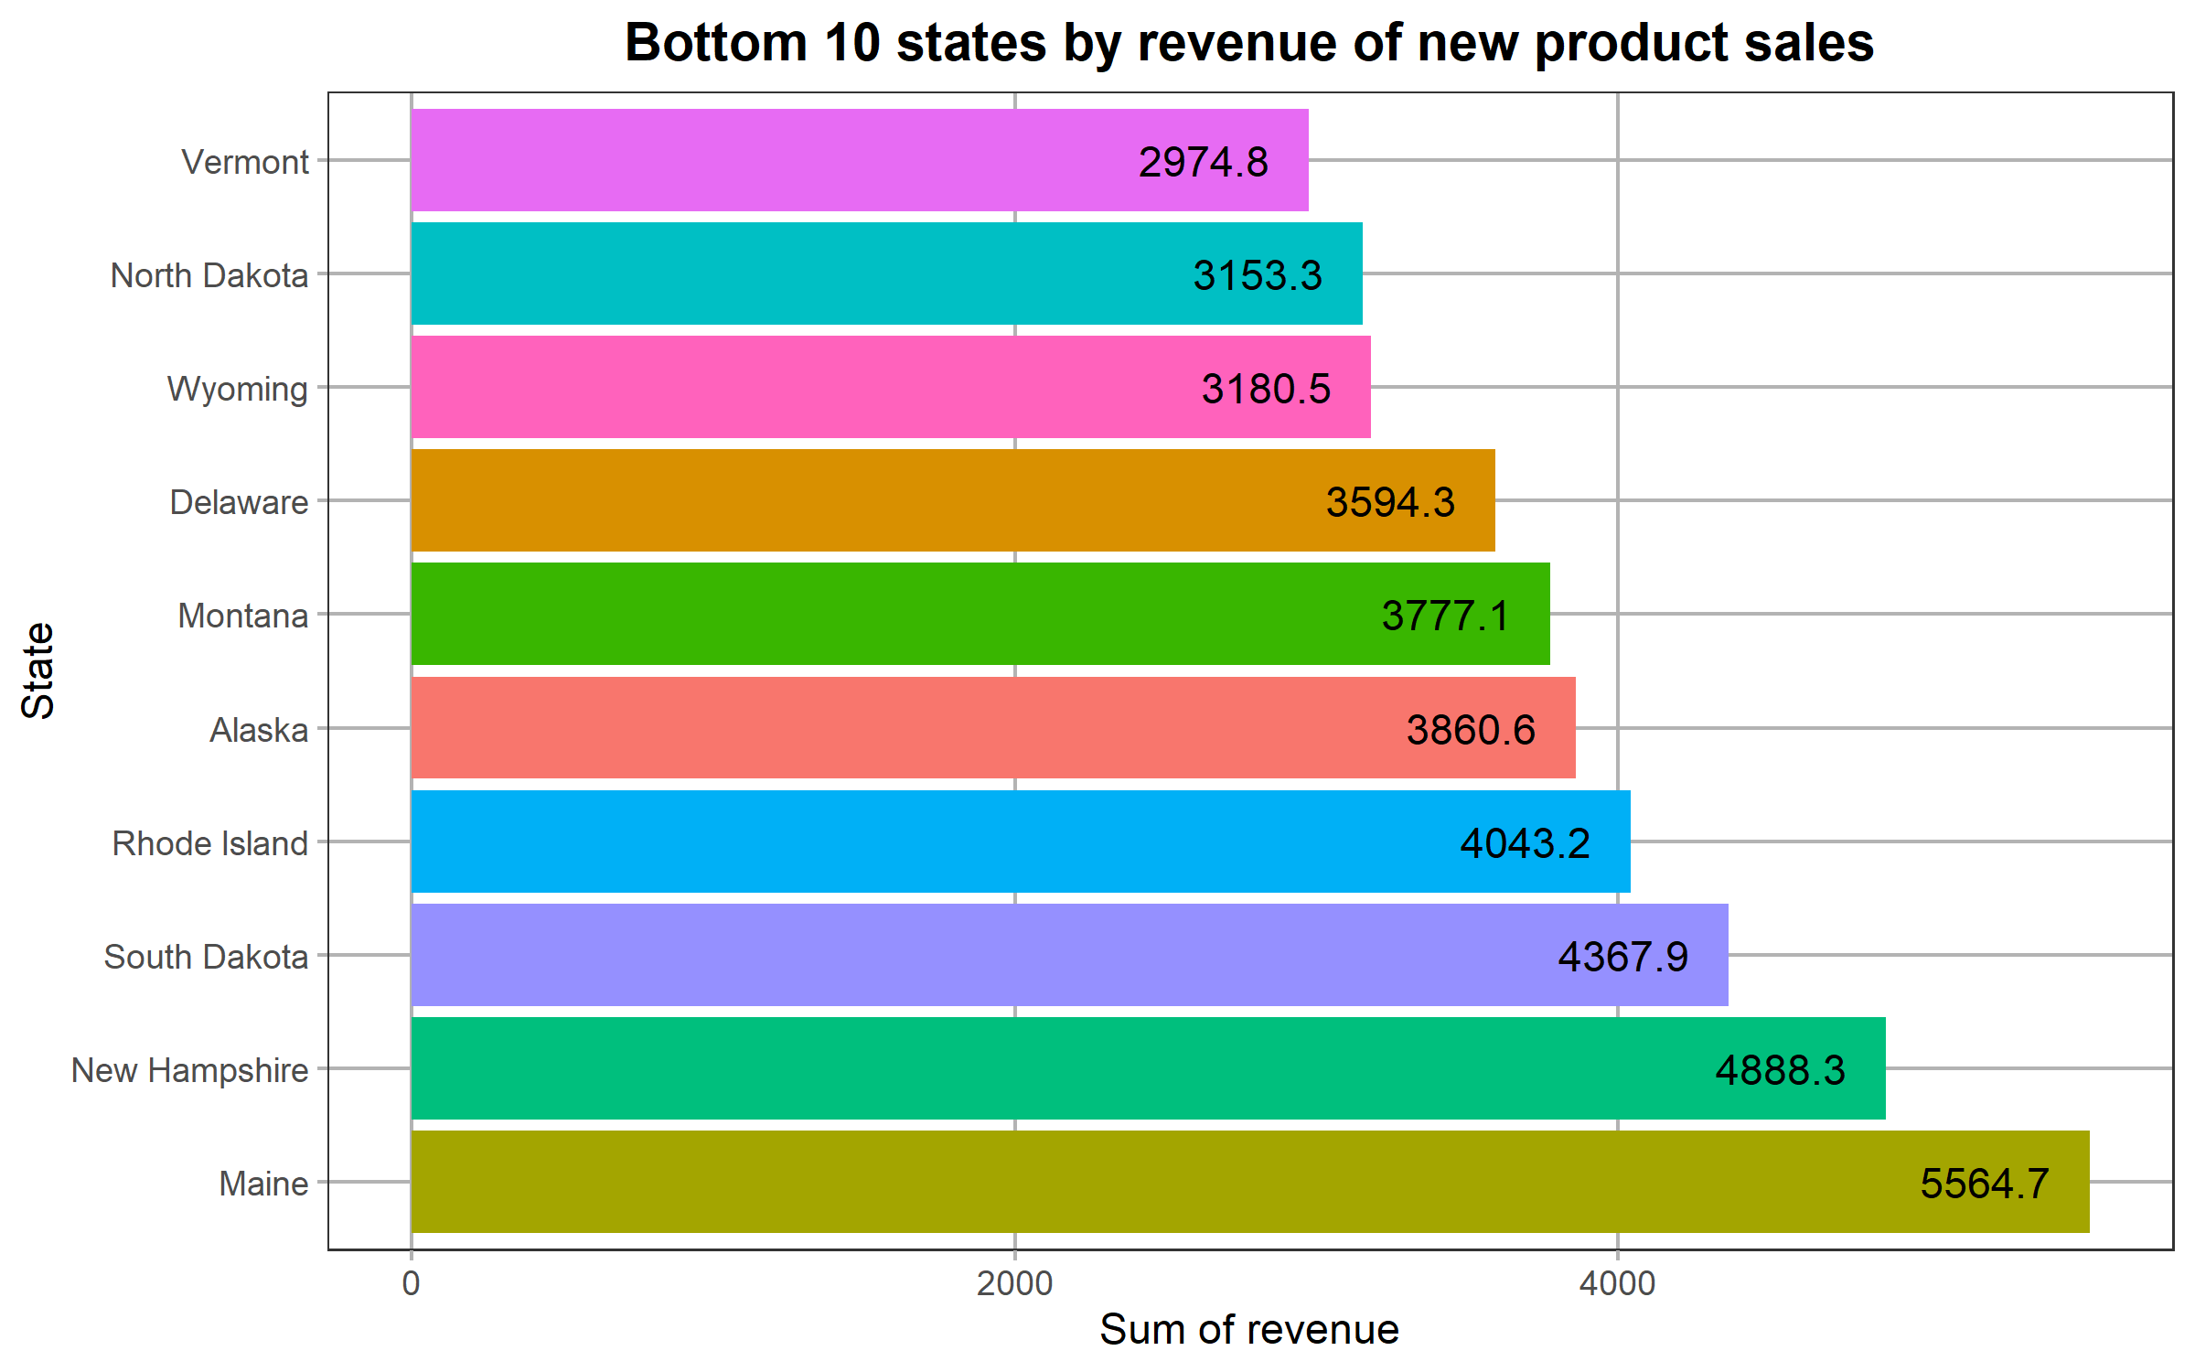
States to keep in mind
29k USD
Average sales revenue by state

Slide 12
Business metrics
Since our goal is to choose the most effective sales approach, I would recommend using the average unit price as our main metric and the spread and average revenue as the reinforcing metrics.
Based on the last 6 weeks data, the average unit price is 9.22 USD, average revenue is 95.7 USD and overall revenue falls between 32.5 USD and 238.3 USD.
These metrics differ greatly between the tested sales methods:
Call: average unit price - 5.01 USD; average revenue - 47.6 USD; interval from 32.5 USD to 71.4 USD.
Email: average unit price - 10 USD; average revenue - 97.2 USD; interval from 78.8 USD to 149 USD.
Email and Call: average unit price - 15.1 USD; average revenue - 184 USD; interval from 122 USD to 238 USD.

Slide 13
Recommendations
Moving forward, I would recommend focusing on the steps below:
- Focus on using the 'Email + Call' as the primary sales method;
- Reduce number of customers contacted only by calls;
- Update and improve the company's site;
- Focus more attention on the bottom performing states:
- Analyze what may be the reasons for lower revenue in the bottom 10 states;
- Update the sales approach according to found reasons;
- Improve the marketing approach in these states to increase brand image and attract new customers.
- Improve data for better quality analysis
- Fix the missing values issue - ensure there are no missing revenue (or other) values;
- Include data about how much time was spent on each customer.

